Slide 1
Céline MK
Artiste peintre
PORTFOLIO
celinemk.jimdo.com

Slide 2
Presentation
The emotions of colour…
“I am glad to share my work with you. I hope that this moment spent in the impression inspired and colorfulness of nature and life will have on you the effect of a brief excursion through my world. For me art is an expression, a sensitivity, an emotion that I encounter everyday on any number of subjects. Creating is a way to share my view of the world and all that is surrounding me, in all its beauty, subtle as it may be. It is a way to share what we often don't take time to see.”
Originally from the region of Lyon, France, this is at nine years old that Celine Mogenier Kolber, will discover her passion for Art: Textures and colors will make sense to her life.
When she began formal lessons, primarily in theory. This became her first approach to oil painting.
Feeling trapped in a very structured style and only being taught by “the manner of“, Céline decided to change the type of education. This is how, in order to give more liberty to the material and be freer to create, from eleven to sixteen years old, Céline changed of studio to discover the real meaning of art, thanks to her mentor “Françoise Bossut”.
Always, Céline was painting, drawing, creating in any way she could. For years she has been encouraged by her husband, family, and friends, when finally an encounter with an American artist, “Lisa Feather”, during a trip to San Francisco pushed her to take the next step. It was at this point that her dream seemed possible. Upon her return to the Netherlands, her mind is made up; she will share her talent and make a living doing so.
Her numerous trips to Texas, Ireland and her life in the Netherlands are sources of inspiration that emanate of her work, but it truly is France and more particularly her “Rhone-Alpine” roots that emerge of her major pieces.
“With oil or with acrylic, dry or oily, watercolor or charcoal or by mixing those, all is matter to expressionism. I like substances, textures, odors. When we know how to look at nature, if you have an idea, a subject running to your head, then it reveals itself. And by these materials, I try to transcribe it.”
CelineMK

Slide 3
Tariffs and Commissions
All of my work are for sell.
The prices are based of the size and the media used.
An oil painting will be more pricy than an acrylic, although I do not use acrylic very often.
Commission paintings are possible (in oil, mix media, inks mix ink and drawings…) at a certain
extent and as long as it correspond to my portfolio and style.
We can talk about it and see what you need and what I can offer.
Prices for commission paintings are not especially more expensive that my collection work.
And the tariffs will be based on the same principles as my collection work.
How to contact me:
Email: celinemk.art@gmail.com
Website: www.celinemk.jimdo.com
Facebook page: http://www.facebook.com/pages/Celine-MK/21510328185421. 3

Slide 4
Inks
celinemk.jimdo.com

Slide 5
Inks
celinemk.jimdo.com

Slide 6
Inks
celinemk.jimdo.com

Slide 7
Inks
celinemk.jimdo.com

Slide 8
Inks
celinemk.jimdo.com

Slide 9
Inks
celinemk.jimdo.com

Slide 10
Oils
celinemk.jimdo.com

Slide 11
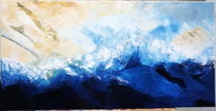
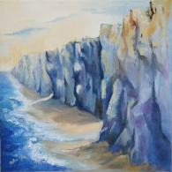
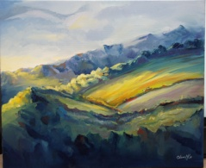
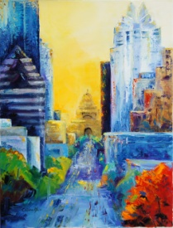
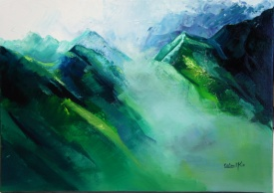
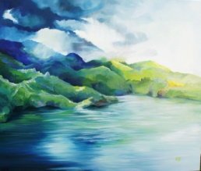
Oils
celinemk.jimdo.com

Slide 12
Oils
celinemk.jimdo.com

Slide 13
Oils
celinemk.jimdo.com

Slide 14
Oils
celinemk.jimdo.com

Slide 15
Oils
celinemk.jimdo.com

Slide 16
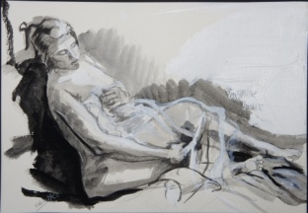
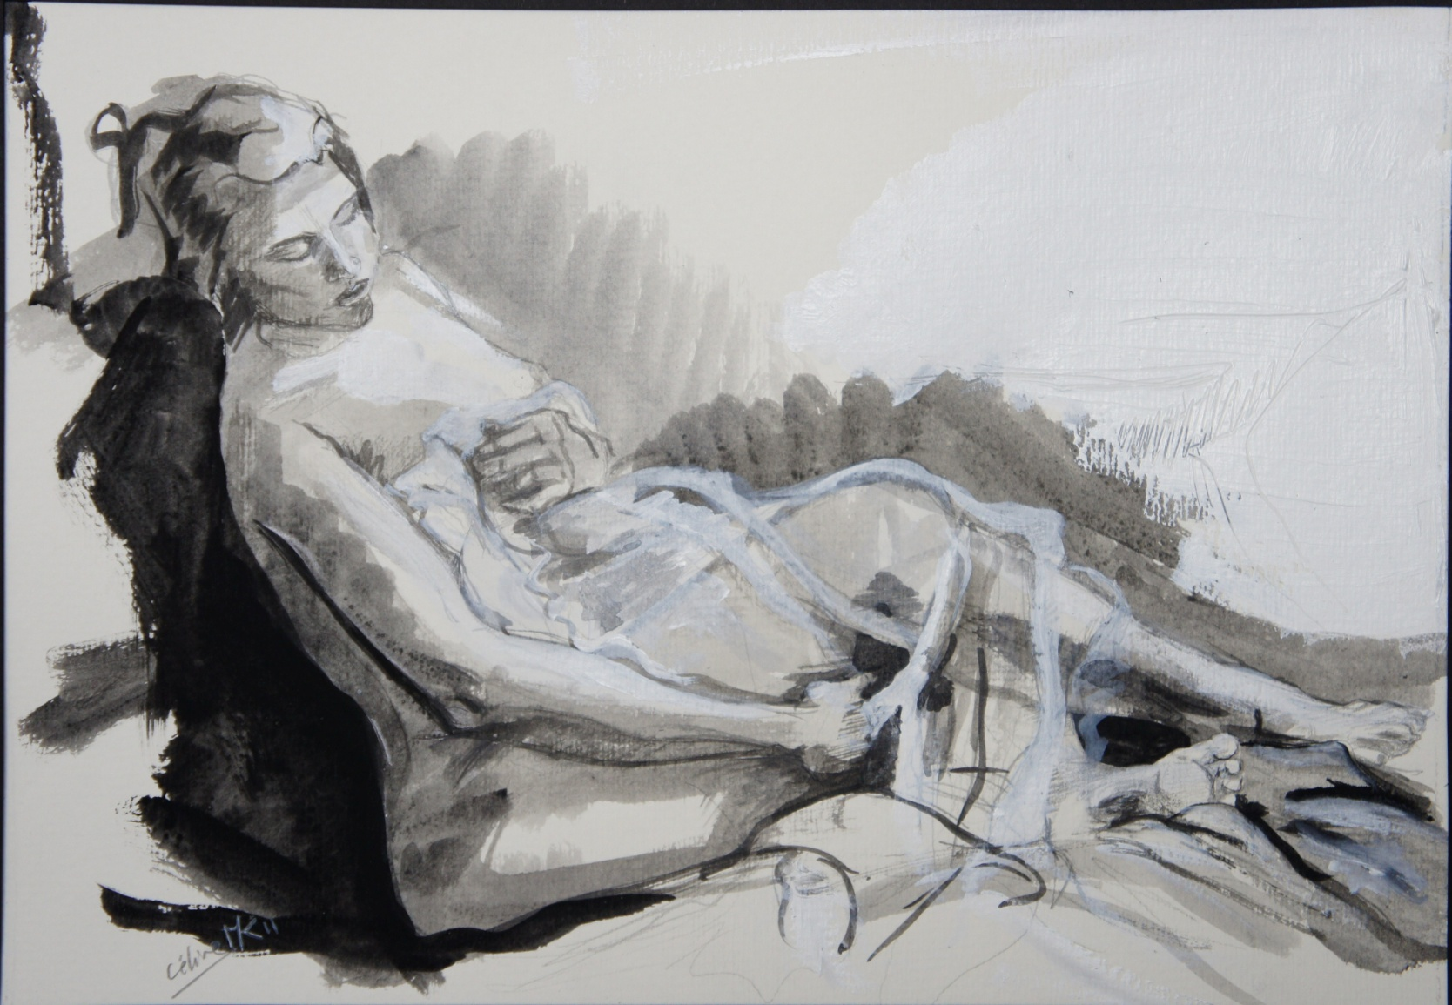
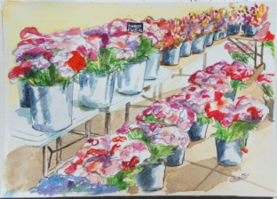
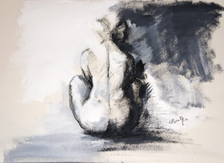
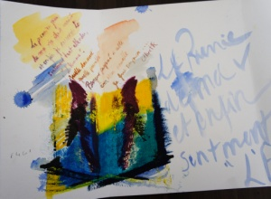
Drawings and mix media
celinemk.jimdo.com

Slide 17
Drawings and mix media
celinemk.jimdo.com

Slide 18
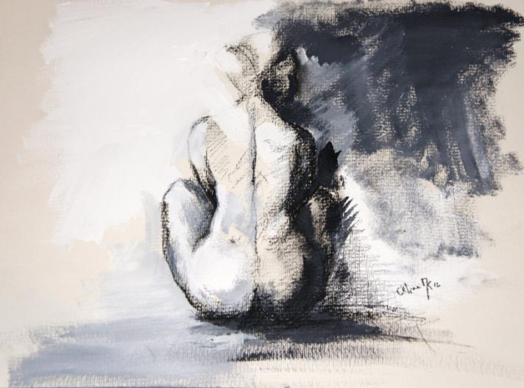
Drawings and mix media
celinemk.jimdo.com

Slide 19
Drawings and mix media
celinemk.jimdo.com

Slide 20
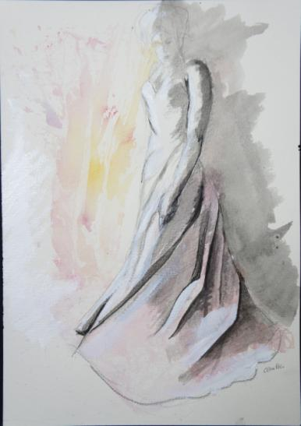
Drawings and mix media
celinemk.jimdo.com

Slide 21
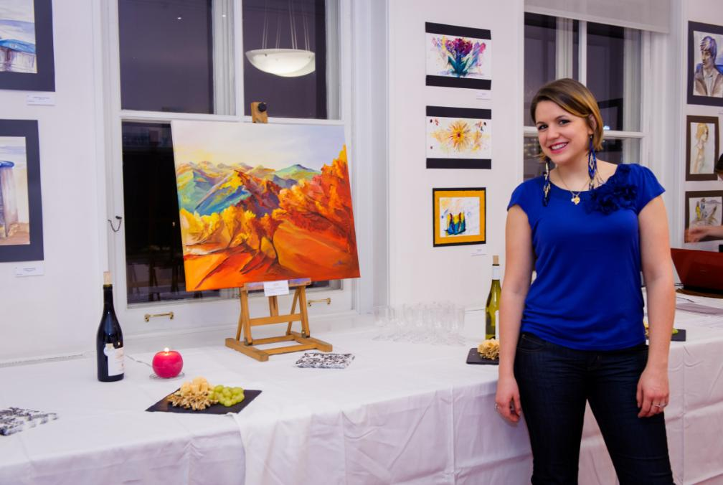
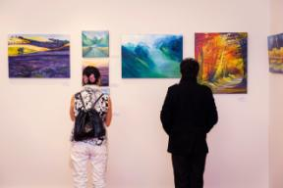
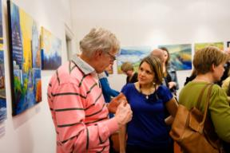
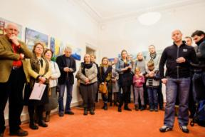
Public work
Video testimony of the exhibition:
celinemk.jimdo.com
“Click here”

